Slide 1


VIGNAN’S INSTITUTE OF MANAGEMENT
AND
TECHNOLOGY FOR WOMEN
DEPARTMENT OF COMPUTER SCIENCE AND ENGINEERING
TECHNICAL SEMINAR
ON
CYBERBULLYING DETECTION
BY
A. SHRUTHIKA
21UP1A05D1

Slide 2

CONTENTS
Introduction
Flow Diagram for application
Details of implementation
Pros and cons
Application
Conclusion

Slide 3
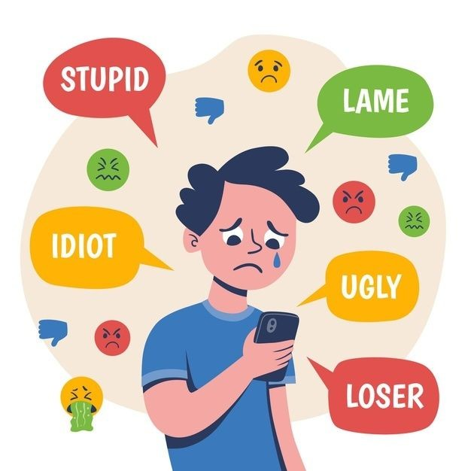
INTRODUCTION

Slide 4

What is Cyber Bullying ?
Using various social media applications, people can experience convenient communication and enjoy enormous information.
Cyber bullying is the use of technology like the internet, email, cell phones, social media or pictures to harass, threaten, embarrass, or target a person. Usually, it occurs among young people. But when an adult is involved, it may mean cyber harassment or cyber stalking, a crime that can have legal consequences and include imprisonment.

Slide 5
Here are some examples of Cyber Bullying:
Sending inappropriate text messages.
Posting statements online that are vulgar or unacceptable.
Sending or posting pictures that are not permitted by you.
Making negative comments.
Blackmailing with certain demands.
Stalking and use of intimidation.
Threats of violence or death.

Slide 6
Flow Diagram for Application

Slide 7
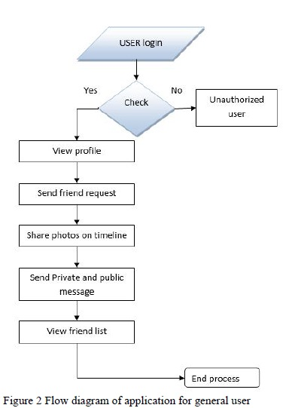
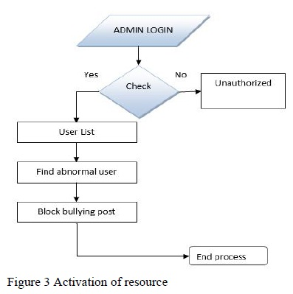
1).Flow diagram for a general user
2).Flow Diagram for an admin

Slide 8

Details of implementation

Slide 9
Front-End
The front end operates off of the python tKinter module to build the primary skeleton of the ui. Users start at a simple login screen where they input their credentials and then press the login button which then automatically guides them to the primary chatting interface. From there the application has a simple display box, a text box to enter messages, and a button to send the messages.

Slide 10
Back-End
The back end works utilizing two different machine learning neural networks.
The first network is a feed forward sentiment analyzer that determines whether a given message is positive or negative. This is done by using the top 500 words within our dataset in order to create a bag of words with a tf / idf normalization. This is then fed into our four layer neural network which then uses the frequencies of each word to determine whether the sentence is positive or negative.
This second network then utilizes a recursive neural network with a long-short-term memory in order to predict what the best output would be given the current state of memory and the message given. After completing the transformation, the message is restructured back into a string of letters based on the output sequence given and the final message is sent to the recipient.

Slide 11
PROS AND CONS
PROS:-
Protection for Victims
Promotes Safer Online Spaces
Assists Authorities
Automated Monitoring
Empowers Platforms
CONS:-
Privacy Concerns
Dependence on AI
Limited Scope
Potential for Misuse

Slide 12
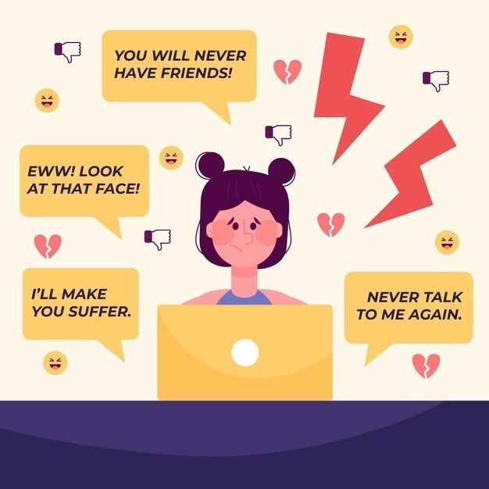
APPLICATIONS
Social Media Platforms
Educational Institutions
Parental Control Apps
Law Enforcement
Workplace Communication Tools

Slide 13
CONCLUSION:-
The findings of this study highlight the need to improve the overall quality of cyber bullying detection systems, presenting important implications for prevention and intervention in cyber bullying
For instance, automatic cyber bullying detection can be used to prevent individuals from receiving harmful online content in social networks ,particularly among adolescents, thus, it may help to reduce the incidence of cyber bullying.

Slide 14
Please let me know if you have any questions

Slide 15

THANK YOU

